Slide 1
Sexual and reproductive health during the COVID-19 pandemic in Brazil
19 January 2022
Brunah Schall, PhD
Fiocruz Minas – Oswaldo Cruz Foundation
Email: brunah.schall@gmail.com
Twitter: @bsep23

Slide 2
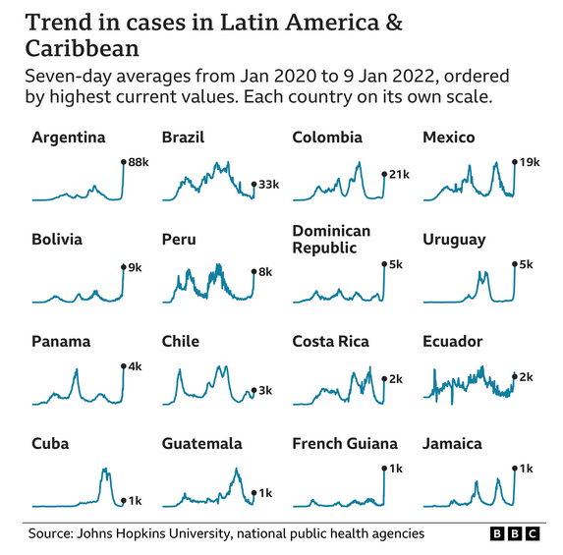
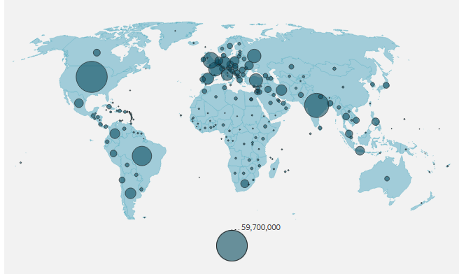
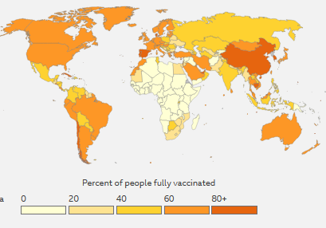
Covid-19 pandemic context in Brazil
Brazil is one of the epicenters of the global pandemic. (621 thousand deaths, 22 million cases)
One of the countries that vaccinated the most. (68% fully vaccinated)
Cases started to drop and recently went up again with omicron variant.
Recently initiated vaccination of children, after controversies involving the government, especially the president
1506 maternal deaths caused by Covid-19, 10 % fatality rate in 2021 → one of the highest in the world → sentinel event
Nº of cases
Vaccine rollout

Slide 3
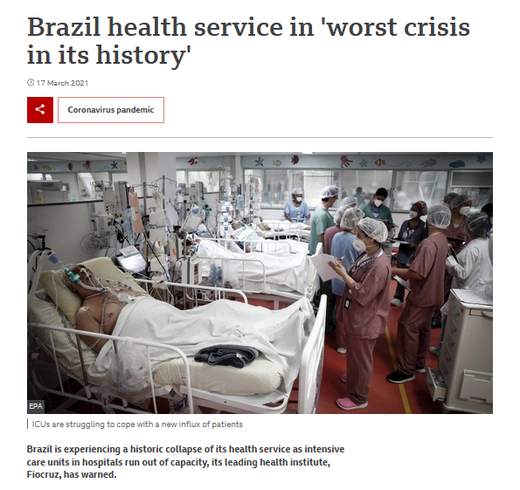
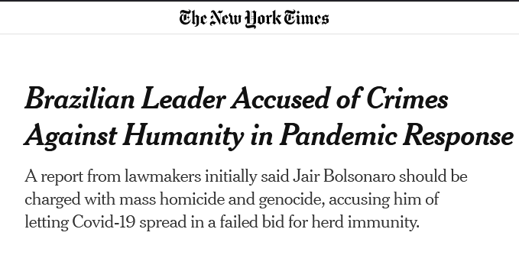
Brazilian government an the public healthcare system during the pandemic
Neoliberal reforms in Brazil since 2016 → reduced investments in the national public healthcare system (SUS).
Uncoordinated federal, state, and municipal responses and lack of political leadership by President Jair Bolsonaro.
The federal government pursued herd immunity as a strategy and invested in an“early treatment kit” that has no scientific support.
Lack of intensive care unit beds and a scarcity of essential supplies for hospital care, such as oxygen and sedatives → historical collapse of SUS in march 2021

Slide 4
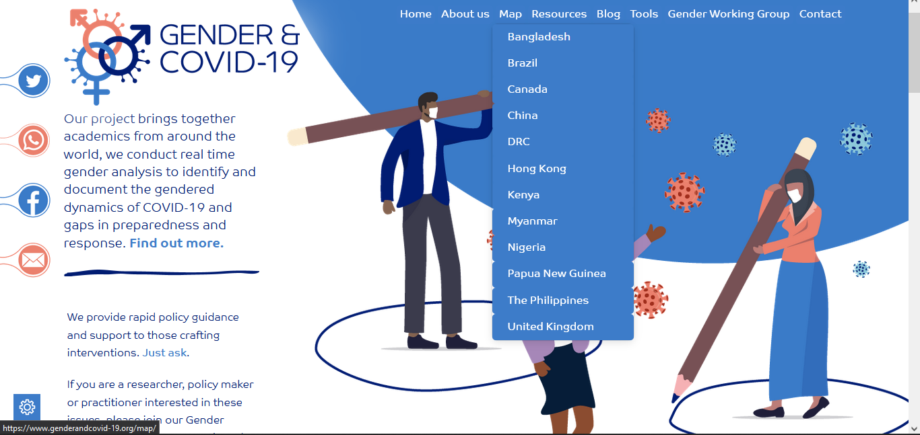
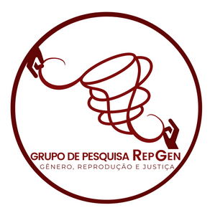
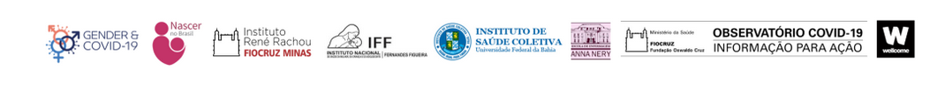
Gender and covid-19 project in Brazil
Gender and Covid-19 international project funded by Gates (genderandcovid-19.org)
Research network – Fiocruz Minas coordination, in partnership with scholars, institutions and networks from different areas, studding several themes.
Sexual and reproductive health (SSH) theme: partnership with Instituto Fernandes Figueiras (Fiocruz Rio) and Bahia Federal University (UFBA).
Research group: Gender, Reproduction and Justice (RepGen) – created in 2009.
Coordinators: Cláudia Bonan, Ana Paula dos Reis
Team: Andreza Rodrigues, Cecília McCallum, Greice Menezes, Nanda Duarte and Ulla Macedo + 10 undergraduate students.
Reaearchers and activistis in sexual and reproductive rights

Slide 5
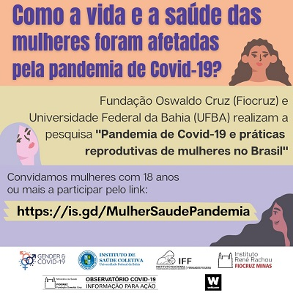
Survey about sexual and reproductive health
Online national survey – July 15 to October 31, 2021.
How the pandemic affected women’s reproductive planning and access to SRH in Brazil? What are the inequalities involved in this?
Activist perspective of the research – produce data to influence public policy, in a context of science denialism and “data blackout” (last public research about SRH was in 2006).
210 questions – women respond to a different number of questions, according to their trajectories
  Identification section
  SRH section I: preventive and tracking exams, breast and cervical cancer, HIV, infertility
  SRH section II: contraception, pregnancy, childbirth, abortion
  Pandemic section: covid-related care
Two open questions: one for general comments and one to give contacts to participate in the qualitative phase
10.405 women replied, 8.384 valid answers.
1.963 women replied the open question
3.859 women said they want to participate in the qualitative phase and gave their contacts

Slide 6

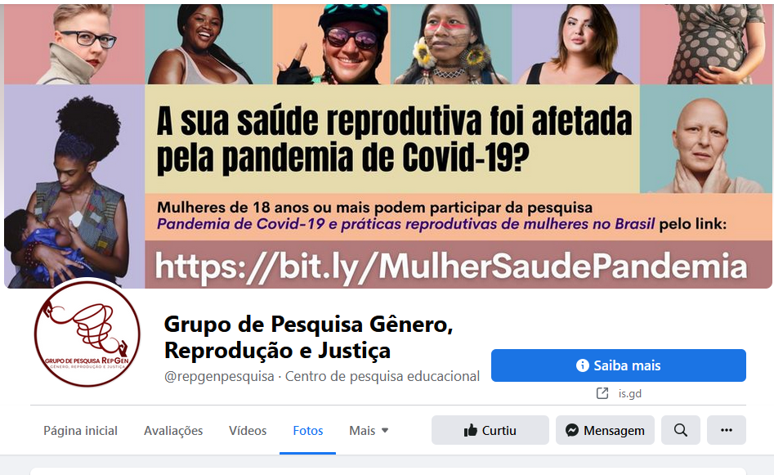
Communication of the survey and of women’s experiences
Social media strategies – Instagram, WhatsApp, Facebook (@repgenpesquisa)
Traditional media: TV, newspapers, radio
Strategies to reach women with different profiles → not only the profile that usually replies (white women, high social class and education).
Challenges to reach women with difficult access to internet, such as indigenous women, quilombolas in rural areas and low-income women
Many women used the open question to unburden their stories → this called the attention to an unfulfilled desire register and share what they are living.
Impossibility to contact all women in the qualitative phase.
Invitation for women who gave their contacts to share publicly their experiences, using a pseudonym → creation of the blog “Juntas Na Pandemia” (together in the pandemic).
The stories shared in the survey were not publish for ethical reasons.
82 testimonials that were received by email were published.
Now the blog is opened to anyone who wants to post their testimonials

Slide 7
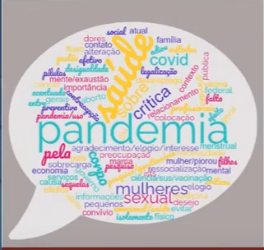
Preliminary results
Statistical analysis are still in progress, but there are some preliminary results from the platform used for the survey (REDCap).
Emerging themes:
  Reduced/closure of SRH services
  Reduced number of SRH professionals
  Alteration of menstrual cycle
  Lack of sexual desire
  Interruption of investigations and treatment of breast and cervical cancer
  Interruption of infertility treatment and investigation
  Difficulties in accessing pre natal services
  Overload of domestic work
  Fear of contamination
  Lack of information, misinformation, fake news
  Impact on mental health
  Domestic violence
  Loneliness, uncertainty about the future, unemployment
There will be more in-depth cross-cup analysis in all the themes according to race/color/ethic, physical conditions (disabilities), differences between private and public health services and regional differences. Also, qualitative interviews will be made to deepen the questions.

Slide 8
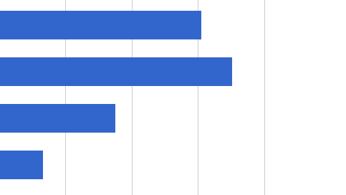
Breast pathology and covid-19
  Question: Before the pandemic, did you do any follow-up to investigate or treat cyst, nodule or breast cancer?
  2.250 said yes (from 8.384) → and they where asked to specify between the following options:
Yes, but I interrupted when the pandemic started (34%)
Yes, and I continued to do it with no difficulties during the pandemic (39,1%)
Yes, and I continued to do it but with difficulties during the pandemic (19,5%)
I started to investigate or treat during the pandemic because I manifested the problem (7,5%)

Slide 9
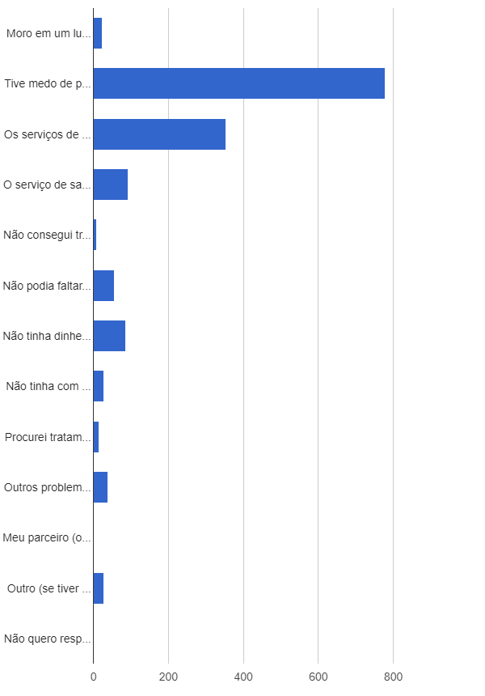
Why did you stop or find it difficult to investigate or treat the breast problem? *(MORE THAN ONE OPTION)
There are no health services to treat the problem where I live (2,2%)
I was afraid of getting covid-19 in the health service (72,8%)
Health services where closed or with reduced hour because of the pandemic (33,1%)
The health service was only attending covid-19 cases (8,7%)
I had no transportation to the health service (0.8%)
I couldn’t miss work (5,1%)
I didn’t have money to pay the service (8,1%)
I had no one to watch my kids or someone I take care of (2,7%)
I searched for alternative treatments (1,4%)
Other health problems got in the way (3,7%)
My partner didn’t let me go (0%)
Other (2,6%)
I don’t want to reply / I don’t know (0%)

Slide 10
Learnings
The importance of data → real time if possible, in order to act
Circulation of qualified information → working with the hypothesis that the fear to go to the health service was highly related to lack of information or misinformation/fake news/denialism
Reorganization of the services and patients accordingly with the needs of each case → in some cases time is everything, to treat the cancer in early stages or to treat the problem before it becomes cancer.
Importance of keeping a memory of the situation and to open spaces for women to share their experiences.

Slide 11
Thank you!

