Slide 1


COVID-19: A driver of marginality in Nairobi’s Informal Settlements
Caroline Kabaria, PhD
Contact: ckabaria@aphrc.org
Presented at International Conference on COVID-19, 2022:
Learning for Future Healthcare Systems in Low-and Middle Income Countries,
JANUARY 2022

Slide 2
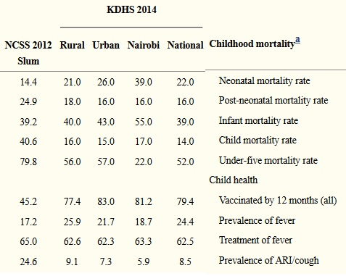
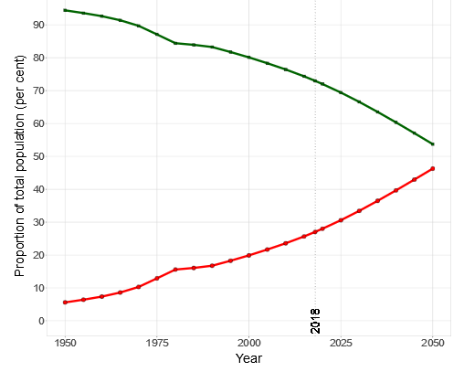
HIDDEN NUMBERS: SLUMS IN OFFICIAL STATISTICS
Many global data collection exercises including censuses do not track spatial distinctions of populations living in places identified as slums
% of total pop
Providing municipalities, city managers, countries, NGOs, donors, and policymakers with more granular data helps them to prioritise interventions and investments
1960 1975 2000 2025 2030
Notes:
Yet, Slums are often invisible in official statistics, hidden within urban averages

Slide 3
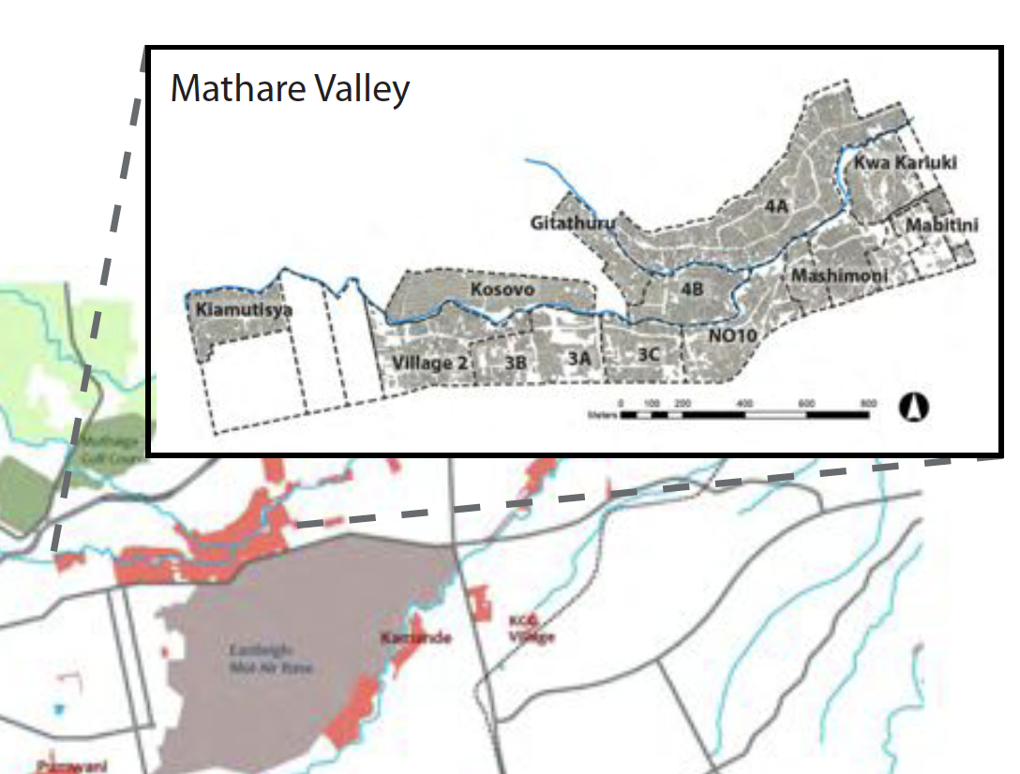
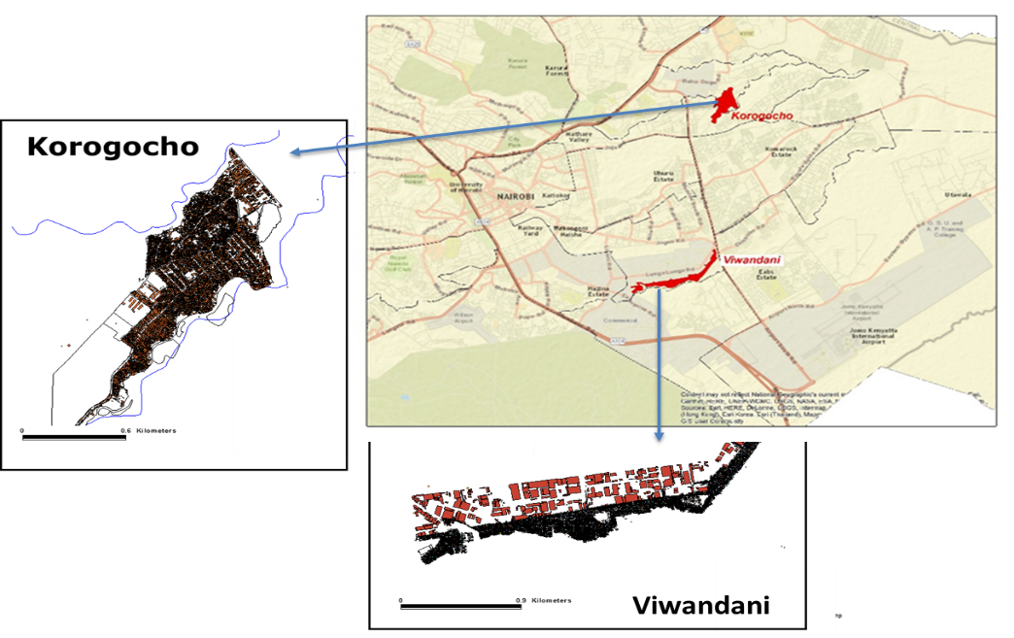



STUDY SITES
Mathare
Notes:
Kenya typifies SSA’s urban crisis
5% annual growth in Nairobi’s slum population
60-70% of Nairobi residents live in informal settlements or in slum-like conditions

Slide 4
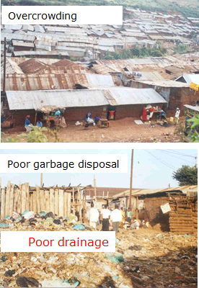
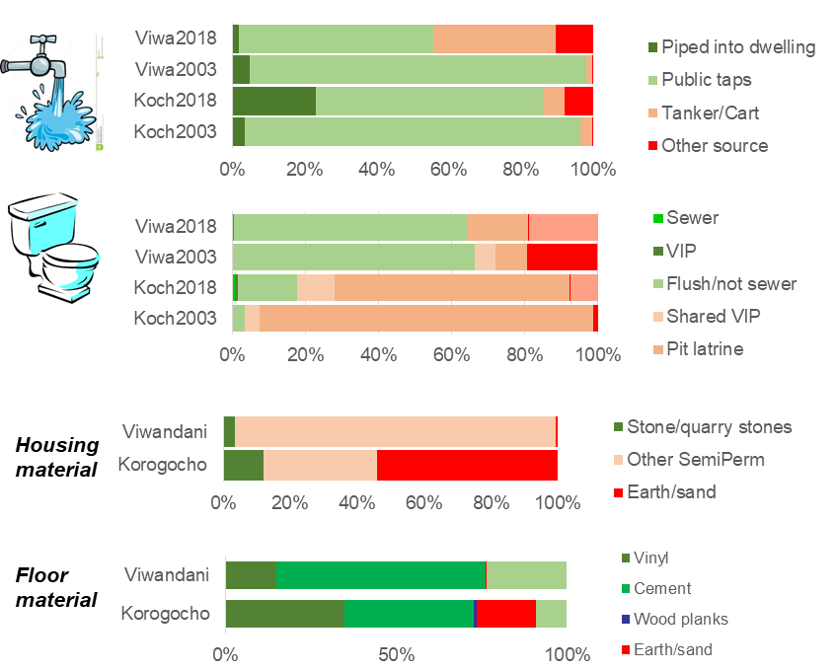
CONTEXT
SLUM HOUSEHOLD CHARACTERISTICS

Slide 5

Health Service Utilisation in Nairobi Slums
Viwandani
Korogocho

Slide 6


LOSS OF LIVELIHOOD – IMPACT OF LOCKDOWN MEASURES AND MOVEMENT RESTRICTIONS
MAJORITY OF RESIDENTS RELY ON THE INFORMAL ECONOMY; STAYING HOME MEANT LOSING THEIR JOBS AND SOURCES OF LIVELIHOOD
“Women are the hardest hit by COVID-19, they are primary caregivers of individuals who are ill during COVID-19 pandemic… Women are not the decision makers in most families and as such, the money they find in a day to day activity ends up in the hands of men in the family.
(FGD, CBO, Korogocho, M)
Proportion NOT currently working
COVID-19 - A DRIVER OF MARGINALITY
Notes:
COVID-19 was described to be a driver of marginality as it exacerbates marginality and vulnerability among the different groups.
NUHDSS 2018 - Occupational categories 18+ by gender and by slum
Majority of residents really on the informal economy - staying home meant losing their jobs and sources of livelihood

Slide 7
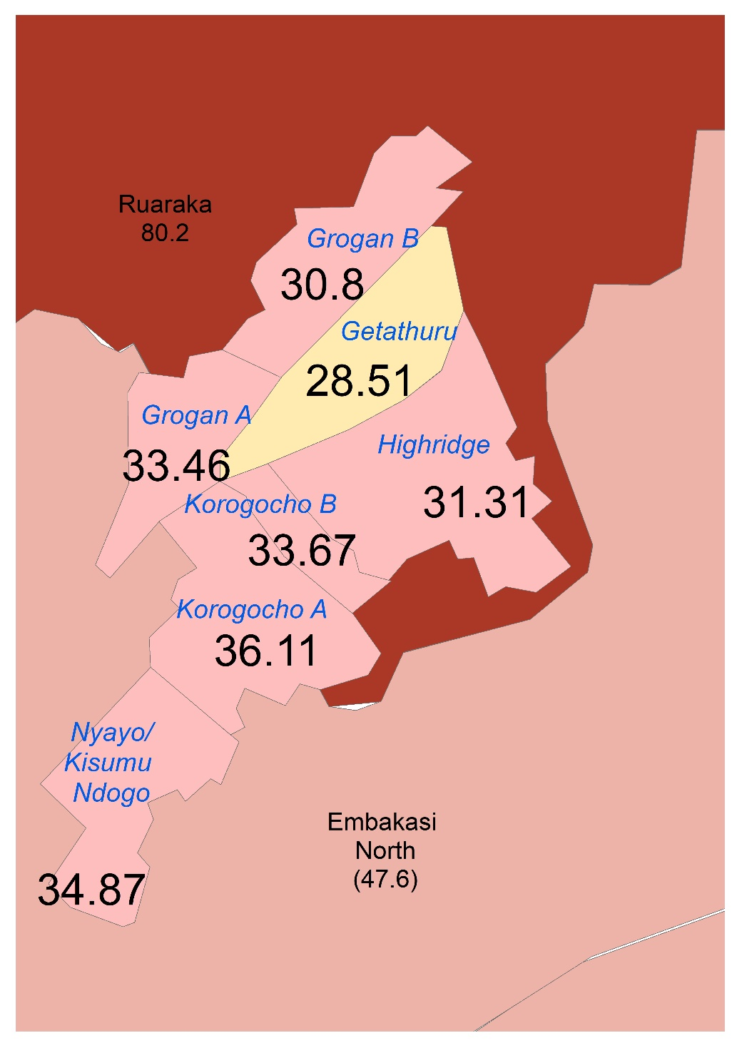
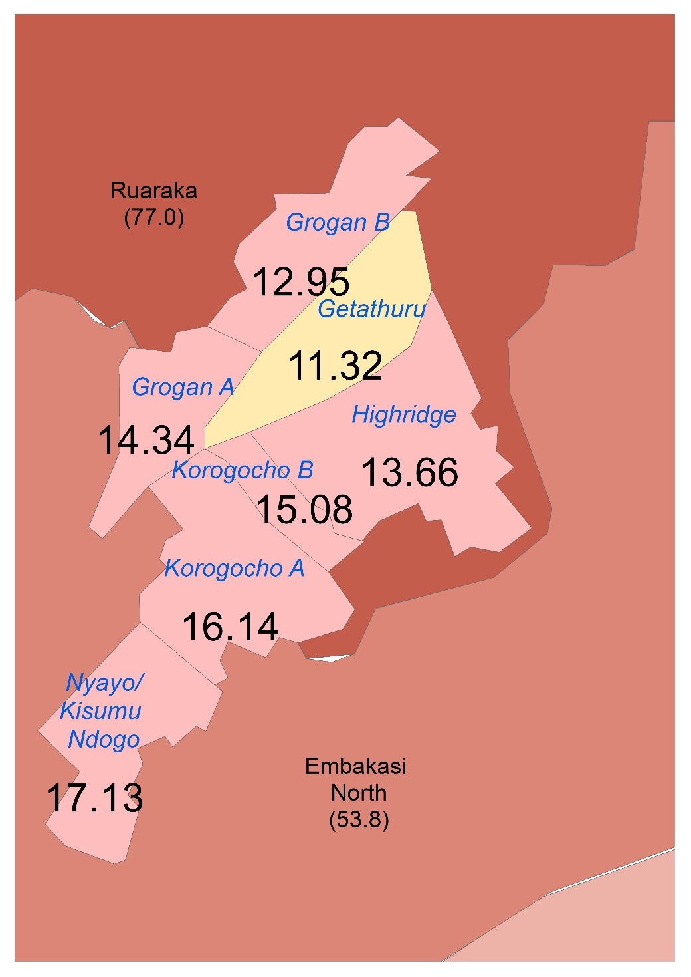
DISRUPTED ACCESS TO HEALTHCARE
AFFECTING ESPECIALLY MOTHERS (& CHILDREN) , RESIDENTS WITH CHRONIC CONDITIONS AND THE ELDERLY
Some health services are compromised during the COVID-19 pandemic… services like mother and child services… even clinics, there are many defaulters as mothers’ fear visiting the health facilities…. Some referral facilities are also overburdened during this outbreak hindering access to ….services.
(FGD, CHV, Korogocho, F)
COVID-19 - A DRIVER OF MARGINALITY
Notes:
Immunisation rates in Nairobi - Slums health indicators are often hidden within urban averages
“Individuals with chronic illness suffer a lot as they need specific medical attention, yet …we lack money to buy drugs during this outbreak as many people have lost jobs…” (FGD, Sanitation Worker, Viwandani, M).

Slide 8


LACK OF ACCESS TO APPROPRIATE INFORMATION ON COVID-19
…further children are limited in accessing timely information on COVID-19 and many cannot express their fears/anxieties.
(FGD, Parents for 8-12 years, Korogocho, F)
PLWD are easily isolated in access to information during COVID-19 outbreak especially hearing and visually impaired… this then limits them accessing COVID-19 related resources among other basic services offered during the outbreak period…
(FGD, Refugees, Viwandani, F)
Elderly people have difficulty accessing COVID-19 related information… they also need someone to accompany them to the health facility which reduces social distancing… Many elderly people are illiterate and not able to interpret COVID-19 messages. (FGD, 35-50 Year-olds, Korogocho, M)
COVID-19 - A DRIVER OF MARGINALITY
Notes:
Lack of access to appropriate information on COVID-19 was identified as a barrier to adhering to public health measures esp for young children, elderly persons, and persons living with disability

Slide 9
CHALLENGES FACING COMMUNITIES IN ACCESSING HEALTH CARE
Inclusion
Lack of documentation
Discrimination/denial of access to the facility
Not designed to accommodate all
Language barrier
Location
Long distance; health camp closed
Access
Inadequate service providers
Inadequate services/services not available/facility closed
Services not affordable
Long queues
Lack knowledge on need for health services
Lack of privacy at the facility
Services not culturally acceptable
Lack of trust on service providers and services
No transport to the facility/costly transport
Safety
Unsafe routes/No floodlights at night
Unsafe health practices in the community
Feared Covid-19 infections
Mis-information on health practices within community
Lack of electricity backup and WASH at the health facilit

Slide 10
Policy and programmatic implications
Financial and social risk protection innovations due to high OOP
Collaboration with other sectors in interventions/operational research in e.g works and transport, WASH, education e.t.c
Empowering lower level health managers to be involved in policy and decision making processes (more bottom-up approaches vs top-down)
Empowering communities to demand for accountability from leaders/service providers
Implementation research on improving quality of primary health care and linkages with allied and tertiary services

Slide 11
Policy and programmatic implications
Disaggregating the deprivation burden of slum residents, makes it easier to highlight issues of importance for people who live in slums and focus attention on these issues for policy makers.
Investments in policies, programs, and research requires slum-specific data systems
  Urban programming is practically at local levels by local governments, more so under Kenya’s devolved system.
  Implementing agencies and local governments need slum specific statistics to measure progress and to evaluate and identify interventions that works

Slide 12





ACKNOWLEDGEMENTS
The UKRI GCRF Accountability for Informal Urban Equity Hub is a multi-country hub with partners in the UK, Sierra Leone, India, Bangladesh and Kenya which we call ARISE.
The Hub works with communities in slums and informal settlements to support processes of accountability related to health. It is funded through the UKRI Collective Fund.

