Slide 1

How Kenya’s Health System Adapted to COVID 19
Dr. Lilian Otiso
Executive Director, LVCT Health
International Conference on COVID-19, 2022
20.1.2022
Notes:
Aboout lvct

Slide 2



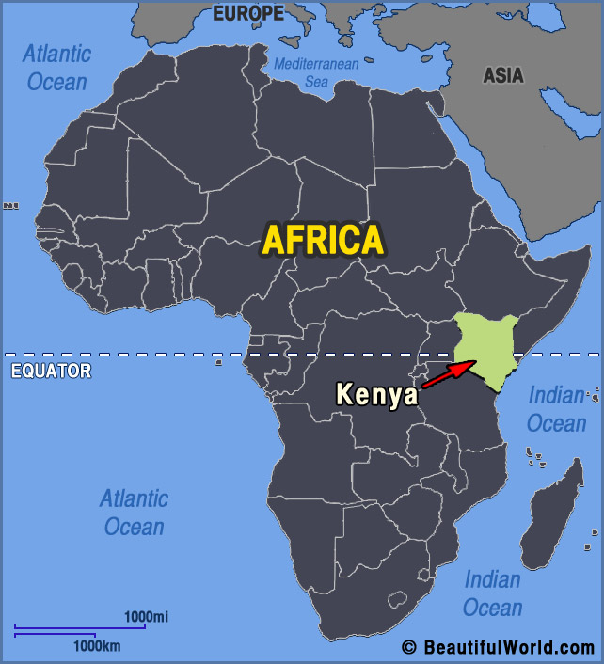

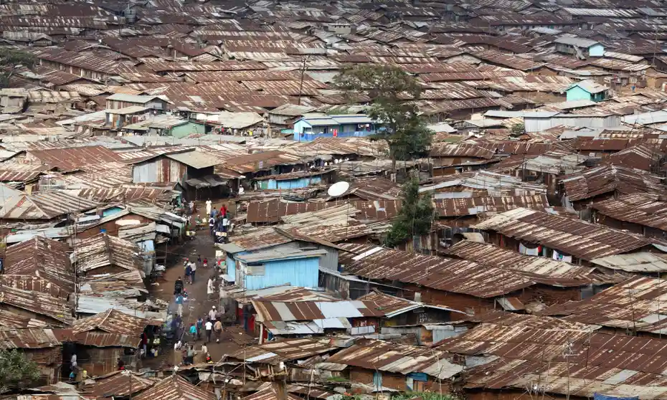
Kenya overview
Notes:
Eastern African country. Popn of 47 million. Majority live in rural areas. LMIC
Key economic activities are farming and tourism
Kenya has a large socio-economic divide - over 60% of city dwellers live in slums. This is a worry with health systems especially COVD that requires physical distance and sanitation measures

Slide 3

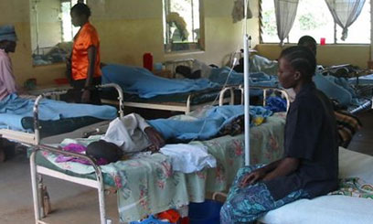
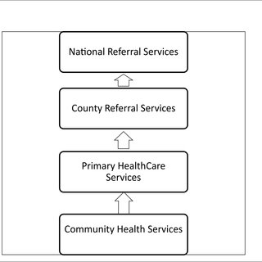
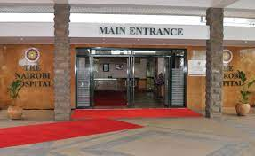
Kenya’s health system
Public vs private
Devolved health structure
Notes:
Kenya has a pluralistic health system – public & private health facilities. Over 50% of health facilities are public
Health care is devolved to 47 counties which are responsible for health services
Major health challenges remain communicable diseases although NCDs are rising with changes in lifestyle due to development

Slide 4
COVID in Kenya
Cases – 318,000
Deaths – 5,500
Vaccinated – 4.7m (17.5% adult population)
Trends of COVID-19 Outbreak Kenya as at 17th January 2022 (Source MOH)
Notes:
Kenya’s 1st case was diagnosed on March 13^{th,} 2020. Multiple waves
Current cases (20th April 2020).
COVID resulted in stretched health systems, showed lack of ICUs, stretched health workers.
Public health approach

Slide 5
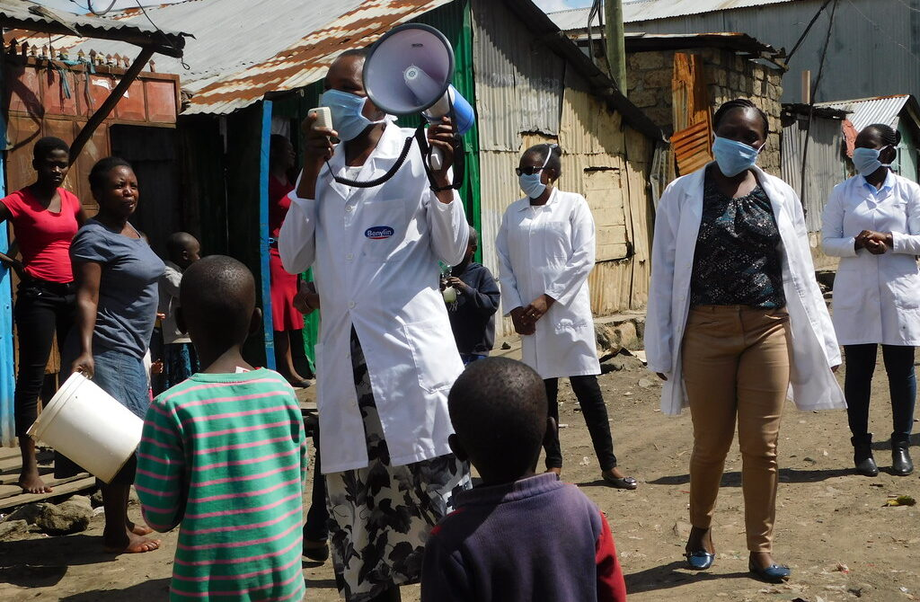
COVID 19 Response measures by govt
National Curfew: 8.00 pm to 4.00 am
#stayhome advise
Restricted movement in and out of 5 counties
Schools closed
Bars & restaurants closed
Public transport – half the passengers
Masks compulsory
Notes:
Govt put in place a public health response system across the country
Announced by national govt and supported by county government
Based on information from public health experts and WHO guidance
Full masks, school closures and closure of entertainment centers. Received with mixed reactions and enforcement has been a challenge involving police etc

Slide 6
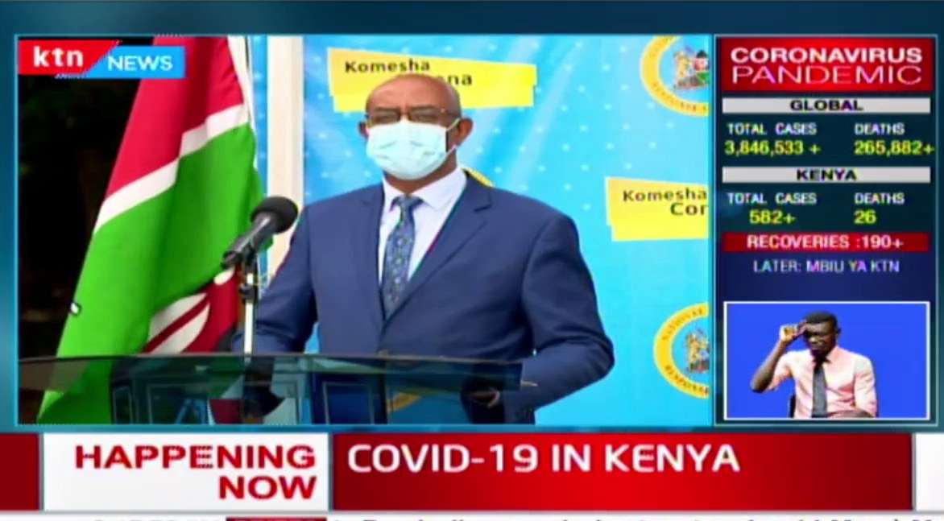
Efficiency in health systems response to COVID-19
Multi-sectoral response – public, private, NGO, FBO
Coordination led by government
Community involvement – CHW
Information campaigns
Centralised real time data
Recognition of needs of the vulnerable
Daily COVID news briefing by MOH
Notes:
The COVID response was led by the national govt. It included multiple partners. The president set up a National Emergency response committee (NERC) with a COVID taskforce set up in MoH reporting to the NERC on a daily basis. The NERC served as the one source of information
Counties set up their own committees as well.
Tracked data on a daily basis
Govt set up guideline and systems for responding including quarantine, isolation, home based care and provided training materials for health workers across the country.
CHWs played a significant role in educating communities and supporting home based care.
The same approach of national coordination, county implementation has been used for COVID vaccine
One key aspect was addressing the needs of the vulnerable – recognizing who they were and what needs to be provided to them to avert crisis. Provision of water, food, PPE and a stipend for those in slums

Slide 7
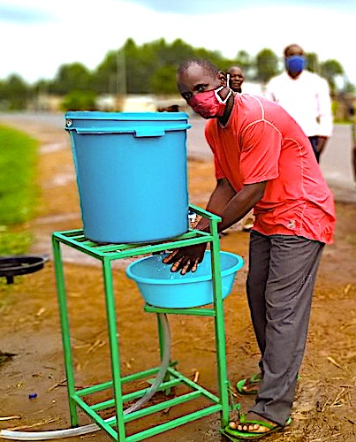
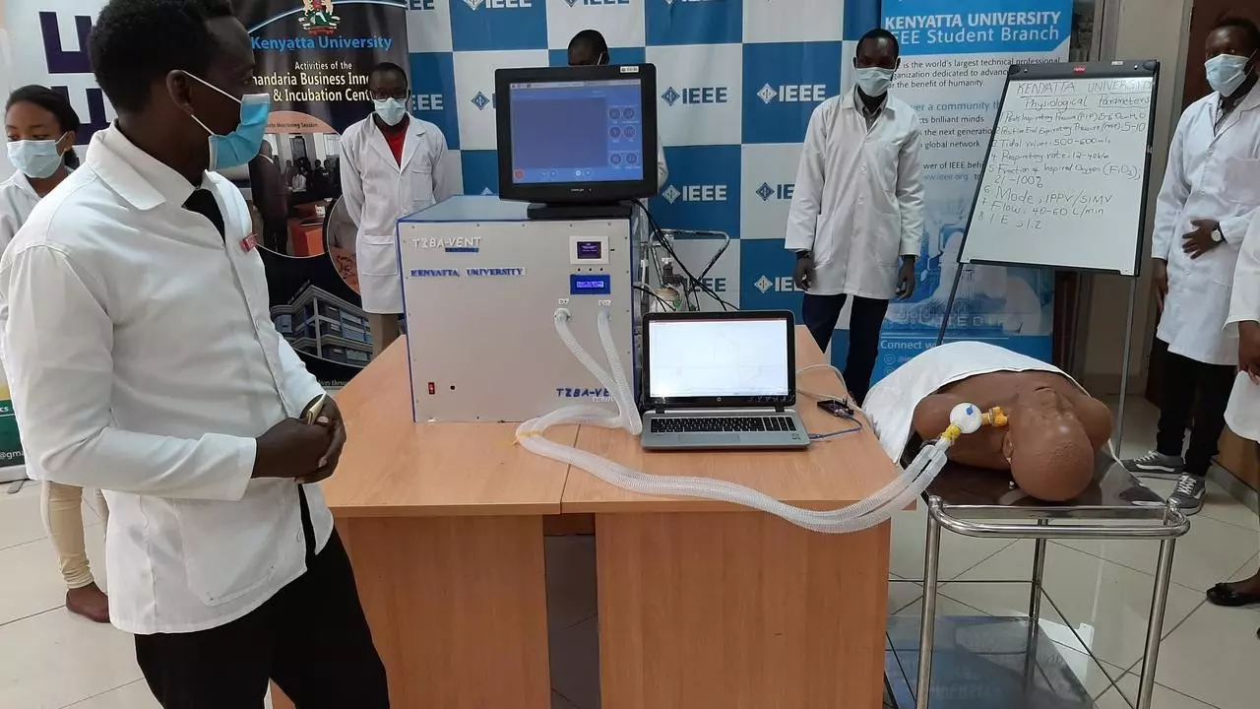
Innovations in health care
Digital technology:
E-learning - Training health workers
Remote working
Online meetings
Teleconsultations, tele-counseling
Local manufacture of PPE, ventilators, beds etc
Courier services to deliver drugs
Multi-month prescriptions for chronic diseases
Notes:
COVID encouraged innovation
Even govt meetings moved online
Judges heard cases remotely
LVCT used bulk SMS to clients to reinforce the COVID-19 and HIV messages and sent 12000 messages to CHWs for information and addressing myths
For HIV Courier services to deliver drugs, Multi-month prescriptions for chronic diseases
We were proud to receive the Trocaire Oscar Romero award alongside Mike Ryan of WHO due to providing education at community level to vulnerable girls to keep them safe from HIV and unwanted pregnancies

Slide 8
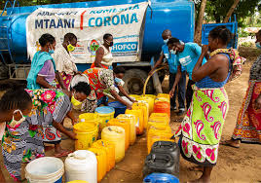
Challenges/gaps noted in the response
The poor, vulnerable and marginalized were left worse off
Limited access to other health services
Stigma and discrimination
Misinformation
Mistrust of government
Gender based violence
Increased teenage pregnancies
Mental health challenges
“will we buy food or masks with the little we get.” Female Sex Worker Nairobi
Notes:
Access to routine health services was affected by initial limiting number of people visiting facilities due to distancing, transformation of some facilities to isolation centers, fear of contracting covid, high transport costs and relocation out of the city during lockdown.
Govt response in the early phase – ‘forced quarantine and isolation, ambulances with men in white to take people to quarantine, quick supervised funerals’ resulted in fear, stigma and discrimination that continues even today. Lessons learned in HIV were largely ignored
Mental health challenges emerged among health workers, other employees especially on testing positive, families etc. LVCT was able to fill that gap using telecounseling

Slide 9
Challenges/gaps noted in the response
The poor, vulnerable and marginalized were left worse off
Limited access to other health services
Stigma and discrimination
Misinformation
Mistrust of government
Gender based violence
Most challenges addressed by community involvement in response
“will we buy food or masks with the little we get.” Female Sex Worker Nairobi
Notes:
Communities have the response to most problems
The community identified strategies to respond e.g. ensuring availability of water in plots, identification and protection of the vulnerable, community education campaigns, community security to mitigate violence
Communities enhance accountability by the govt, NGOs and other stakeholders

Slide 10
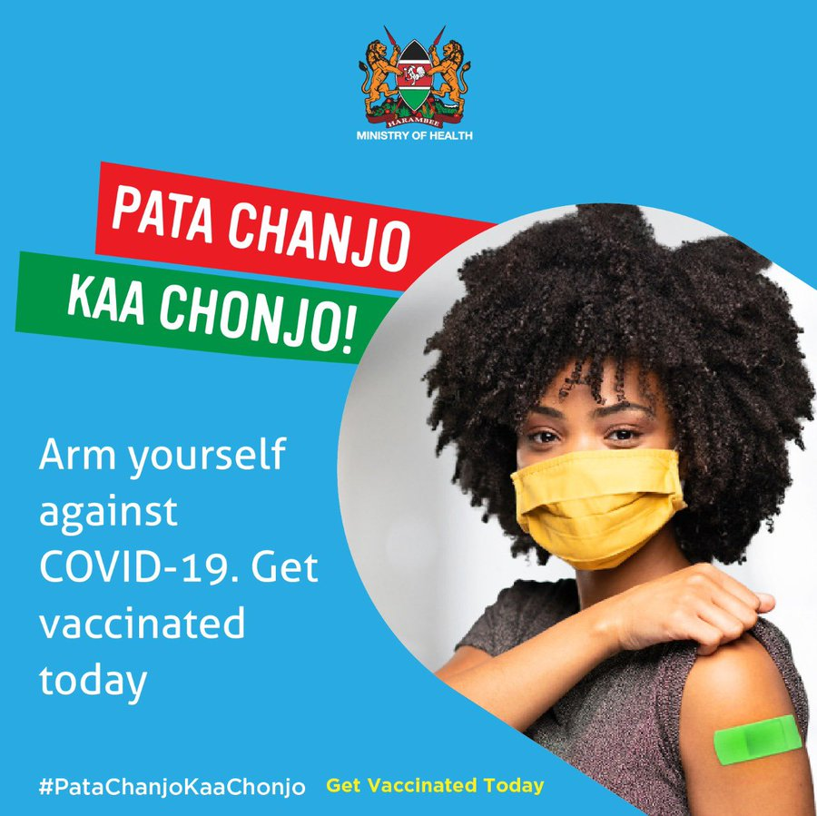
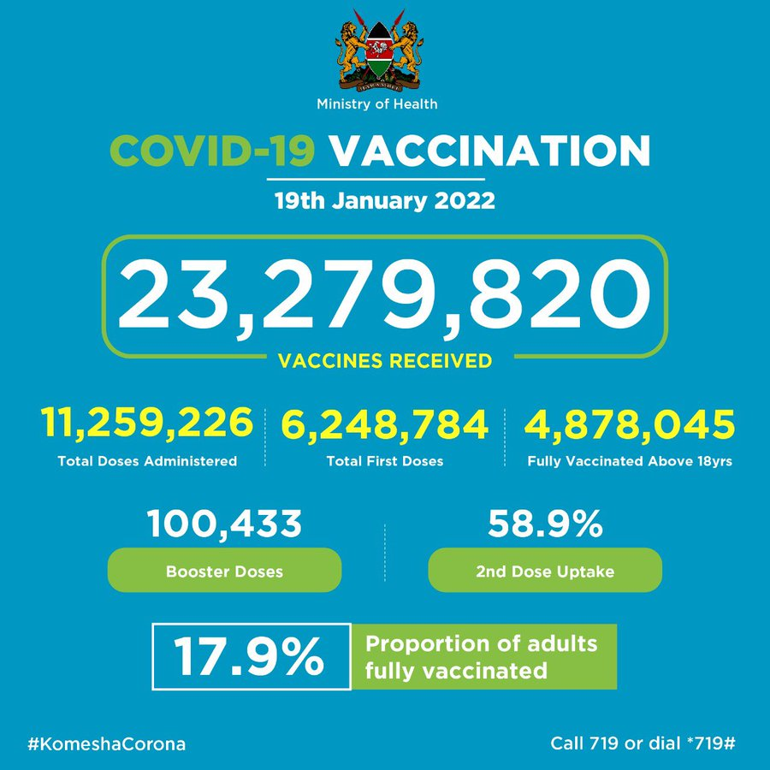
COVID-19 Vaccination
Notes:
The govt has pushed for vaccination drives across the country.
The rate is still much lower than the developed countries. Key challenge is access especially in rural areas.
More aggressive campaigns needed to reach all people and address misinformation and hesitancy

Slide 11
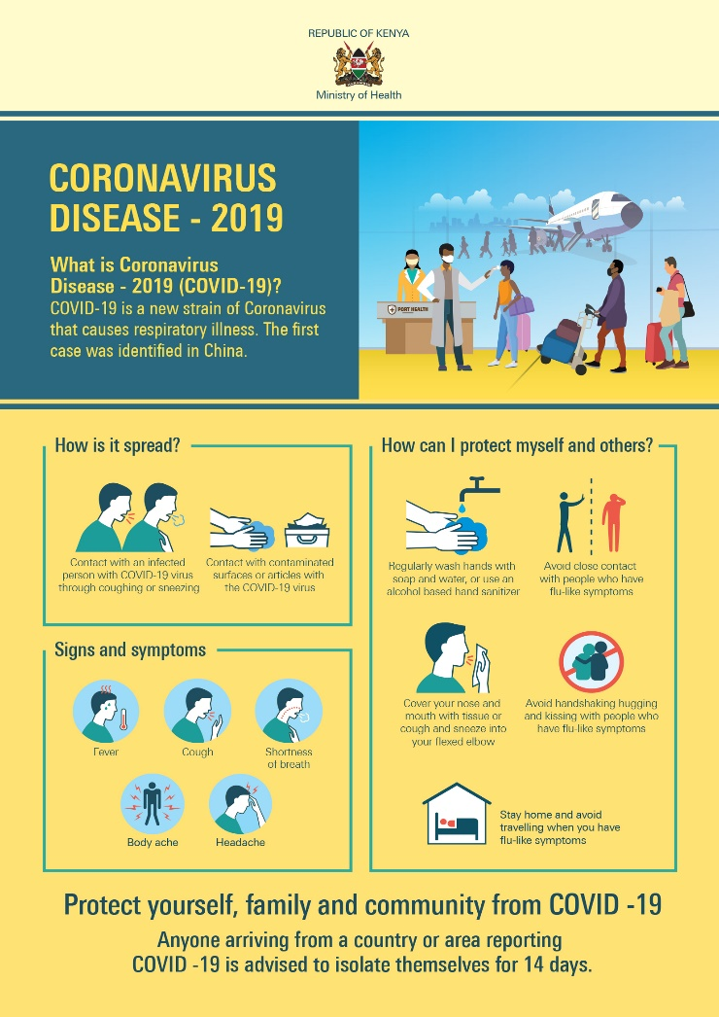
Key messages
Successful efficient health systems responses to pandemics requires:
Public health response with govt coordination & multi-sectoral engagement
Community engagement is critical to address trust, misinformation, to reach the vulnerable & encourage accountability
Innovation – the health system must encourage and nurture innovation to be adaptive and resilient

Slide 12
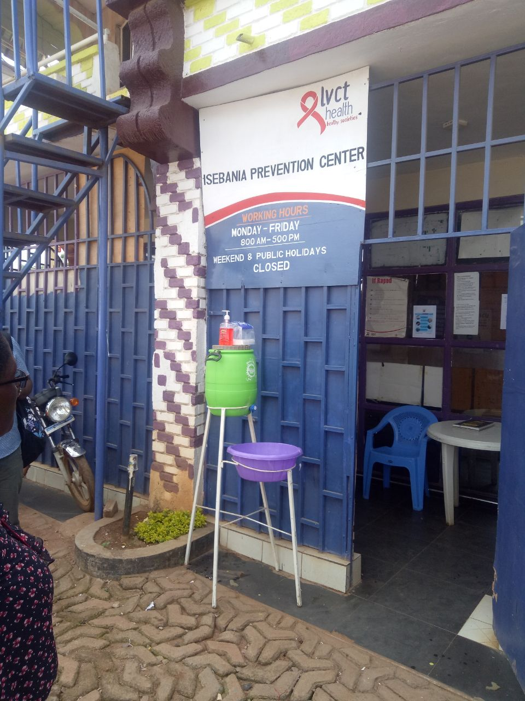
CONTACT US:
Email: lilian.otiso@lvcthealth.org; enquiries@lvcthealth.org
Facebook: LVCT Kenya
Twitter: @lvctKe
Linkedln: LVCT Health
Website: www.lvcthealth.org

