Slide 1



Risk Communication and Health Systems Trust among the Urban Educated Groups in Bangladesh
Taufique Joarder, Public Health Foundation, Bangladesh
20 January 2022

Slide 2
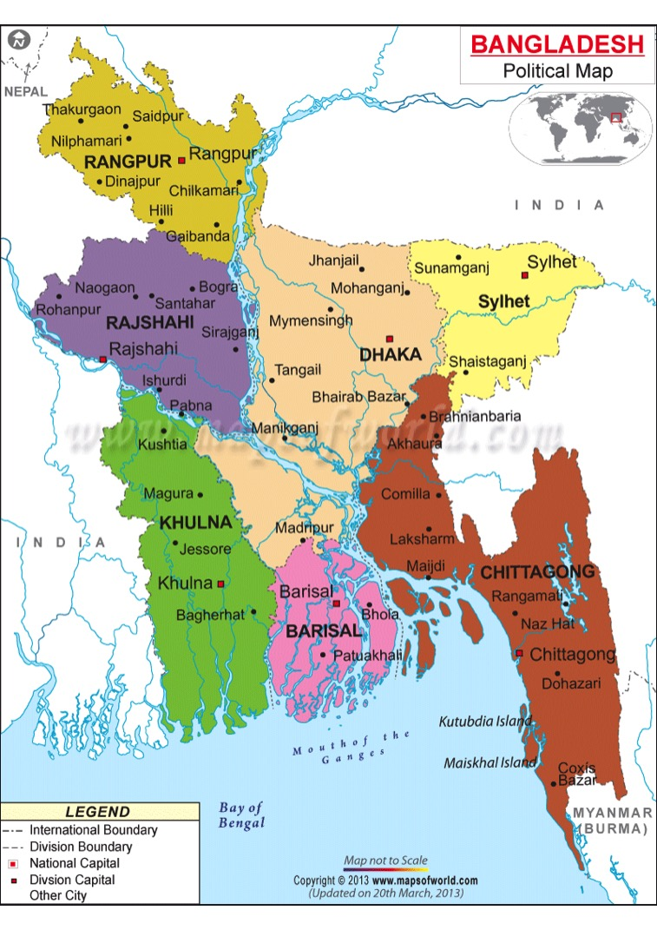
What are Risk Communication &
Health Systems Trust?
Risk Communication: Range of communication capacities required through the preparedness, response & recovery phases of a serious public health event to encourage informed decision making, positive behavior change & maintenance of trust. [WHO 2021]
Trust: Implicit understanding between 2 or more parties that neither will exploit the interests of others. [Abelson et al. 2009, Gilson et al. 2003, 2006, Platt et al. 2018]
In COVID-19: Health system is expected to protect people, and stewards will not exploit their vulnerability. [Gilson et al. 2003]

Slide 3
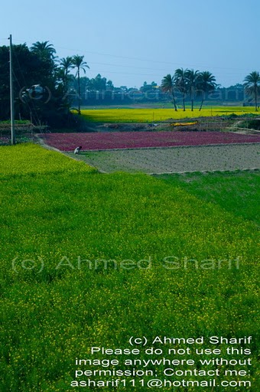

Importance of Risk Communication
& Health Systems Trust
Improved risk communication
  Improves technical & managerial decision-making
Improves care-seeking
  Access, utilization, adherence, continuity > public health, satisfaction
Risk Communication
Fosters cooperation among diverse stakeholders
Garners social order for good governance
Facilitates pandemic response activities
  Contact tracing, vaccination
Facilitates ‘adaptive leadership’
Lack of trust invokes stigma
  Obstructs case detection, quarantine, isolation
Health Systems Trust

Slide 4
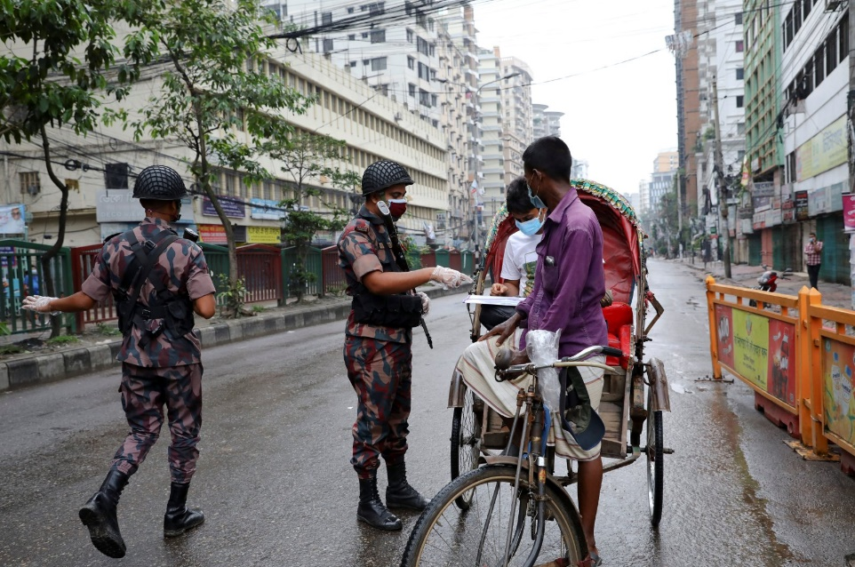
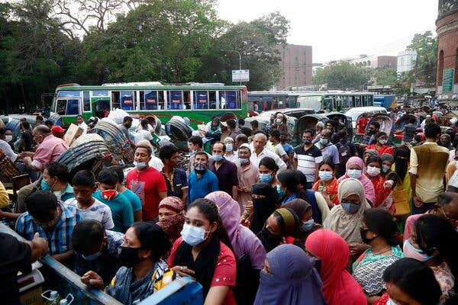
Methods
Study design: Explanatory mixed-methods
Online survey
  Online questionnaire survey in June 2020
  Sample size 508
FGDs
  Video conference in June 2020
  7 FGDs with 50 clinicians and non-clinicians
Results triangulated

Slide 5
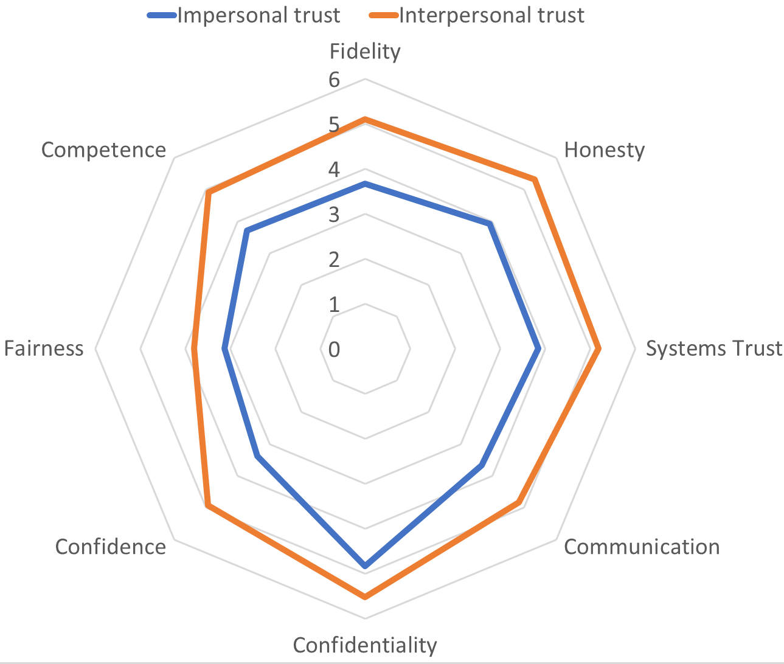

Results-Quantitative
 | Impersonal | Interpersonal
Average | 3.77 | 4.95
Communication | 3.67 | 4.83

Slide 6
Results-Qualitative (Impersonal)
Criticism on the decision to disguise lockdown as a ‘general holiday’
“When they [government] say it is a ‘general holiday’ instead of ‘lockdown’, people confuse it with something festive. That’s why we saw people going to Cox’s Bazar [a popular tourist destination] for tourism purposes. Some of my friends even got married during this period, taking advantage of the ‘general holiday’.” [FGD-3, undergraduate students of public health at a public university, non-clinical]

Slide 7
Results-Qualitative (Impersonal)
Increasing lockdown week by week without supportive information and effective communication
  People failed to take preparation
  Gave the impression of unreadiness & unpreparedness
  Lack of public confidence
  Leading to ineffective lockdown
Irresponsible remarks by political leaders
Giving false hope, knowing that they were not prepared

Slide 8
Results-Qualitative (Impersonal)
Conflicting statements from different responsible persons and entities on opening the garment industries only to change the decision multiple times without clear directions
BGMEA [national trade organization of garment manufacturers] ordered garment workers to return to Dhaka to save their job. After they returned by thousands, braving the coronavirus infection, BGMEA declared that the factories will not open. On the other hand, the police announced that they will not allow anyone to enter Dhaka. The innocent workers were caught between a rock and a hard place, just because of the communication gap among different departments." [FGD-2, graduate students of public health of a private university, clinical]

Slide 9
Results-Qualitative (Interpersonal)
Doctors spreading misinformation through social & mainstream media
Some doctors were found promoting unproven medicines
“I found many of my doctor friends posting about different treatments for COVID-19. I think this may confuse and mislead people, as different doctors are saying different things.” [FGD-2, graduate students of public health at a private university, clinical]
“Some [doctors] are saying plasma therapy is the solution, some are promoting different other drugs like hydroxychloroquine even though the WHO is saying there is no specific treatment for COVID-19.” [FGD-6, renowned public health experts, clinical]

Slide 10
Results-Qualitative (Implications)
Resulting in negative public perceptions
Resulting in stigma
“When the schools were closed, my mother went to Kutubdia [a distant island, respondent’s ancestral home] with my siblings. I heard from her that people of Kutubdia are not even believing that any such disease even exists in reality. They think it’s a hoax, or a propaganda being spread by the government for a clandestine purpose. People are not maintaining any health messages delivered by the government.” [FGD-5, service holders of different professions, non-clinical]
“We are seeing news like returnee expatriates are denied entry to their homes, doctors are driven out of their residence—Government needs to demonstrate how to form the culture of respect, for example, the local leaders, imams, etc. can be role models of counteracting stigma.” [FGD-5, service holders of different professions, non-clinical]

Slide 11


Recommendations (Contd.)
Publications:
1. Joarder et al. Trust in the Bangladeshi health system during the COVID-19 pandemic: A mixed-methods exploration. Accepted in Journal of Public Health and Development
2. Joarder et al. Urban educated group's perceptions of the COVID-19 pandemic management in Bangladesh: a qualitative exploration. Published in F1000Research
Transparency in COVID-19 data and decision-making
Free flow of correct directives and information
Scientifically oriented RCCE and SBCC strategies
Engage religious, cultural, political, & community-based forces
Explicit policy & guideline to promote a culture of respect against stigma
Acknowledgement:

Slide 12
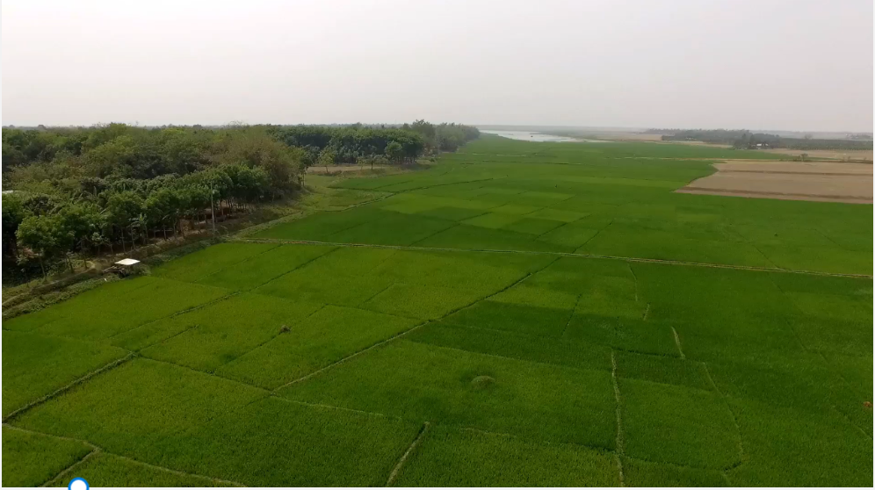
Contact:
Dr. Taufique Joarder, MBBS, MPH, DrPH (Johns Hopkins)
Email: taufiquejoarder@gmail.com; joardert@who.int
Skype: taufique.joarder
Mobile: +8801715167977
Website: www.taufiquejoarder.com
THANK YOU

