Slide 1



A Shared Agenda for Gender & COVID-19 Research
Final Results adapted for Panel on Envisioning a Post-COVID-19 Health System, International Conference on COVID-19, January 21, 2022)
Notes:
Very brief, primarily to say it was lead as a partnership between SOPH & IIGH, sharing relevant results to add to the discussion

Slide 2

Why does it matter?
While there is recognition that governments and political leadership must do more to address the gendered determinants of the pandemic, serious gaps in integrating and prioritizing sex and gender in COVID-19 research and responses remain
Clinical Trials
Only 4% of 4,420 registered SARS-CoV-2/COVID-19 studies explicitly reported a plan to include sex/gender for analysis
Health Services
Across 205 countries, only 17 report sex-disaggregated data on testing, 180 on confirmed cases, 74 on hospitalization, 19 on ICU admissions and 135 on deaths
Health Workforce
In Brazil, 63% of physicians reported receiving PPE vs only 30% of CHWs
Health Policy
Across 334 task forces assessed, women made up on average 24% of the membership of these taskforces and only led 19% of them
Notes:
Spend time on each slide, since this is a diagnostics of what is currently wrong with our health systems
Nat Commun
. 2021 Jul 6;12(1):4015.
doi: 10.1038/s41467-021-24265-8.
Lack of consideration of sex and gender in COVID-19 clinical studies
Emer Brady ¹, Mathias Wullum Nielsen ², Jens Peter Andersen ¹, Sabine Oertelt-Prigione
Sex and gender differences impact the incidence of SARS-CoV-2 infection and COVID-19 mortality. Furthermore, sex differences influence the frequency and severity of pharmacological side effects. A large number of clinical trials to develop new therapeutic approaches and vaccines for COVID-19 are ongoing. We investigated the inclusion of sex and/or gender in COVID-19 studies on ClinicalTrials.gov, collecting data for the period January 1, 2020 to January 26, 2021. Here, we show that of the 4,420 registered SARS-CoV-2/COVID-19 studies, 935 (21.2%) address sex/gender solely in the context of recruitment, 237 (5.4%) plan sex-matched or representative samples or emphasized sex/gender reporting, and only 178 (4%) explicitly report a plan to include sex/gender as an analytical variable. Just eight (17.8%) of the 45 COVID-19 related clinical trials published in scientific journals until December 15, 2020 report sex-disaggregated results or subgroup analyses.

Slide 3
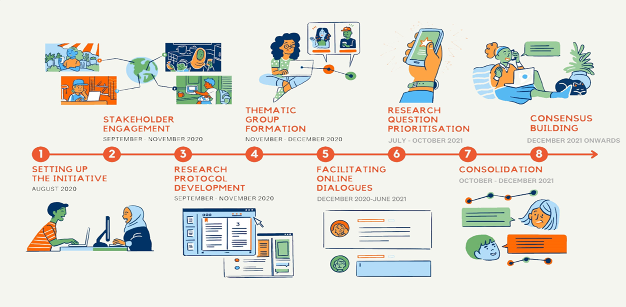
Global and regional conversations
5 Global Meetings
4 Regional Consultations
More than 900 participants: through the discussion board, webinars & surveys
www.ghbuzzboard.org
Arabic, Chinese, French, English, Spanish, Portuguese
Notes:
Very brief to just say that there were multiple ways to engage over the past year and a half

Slide 4
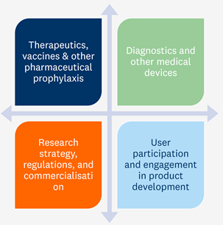

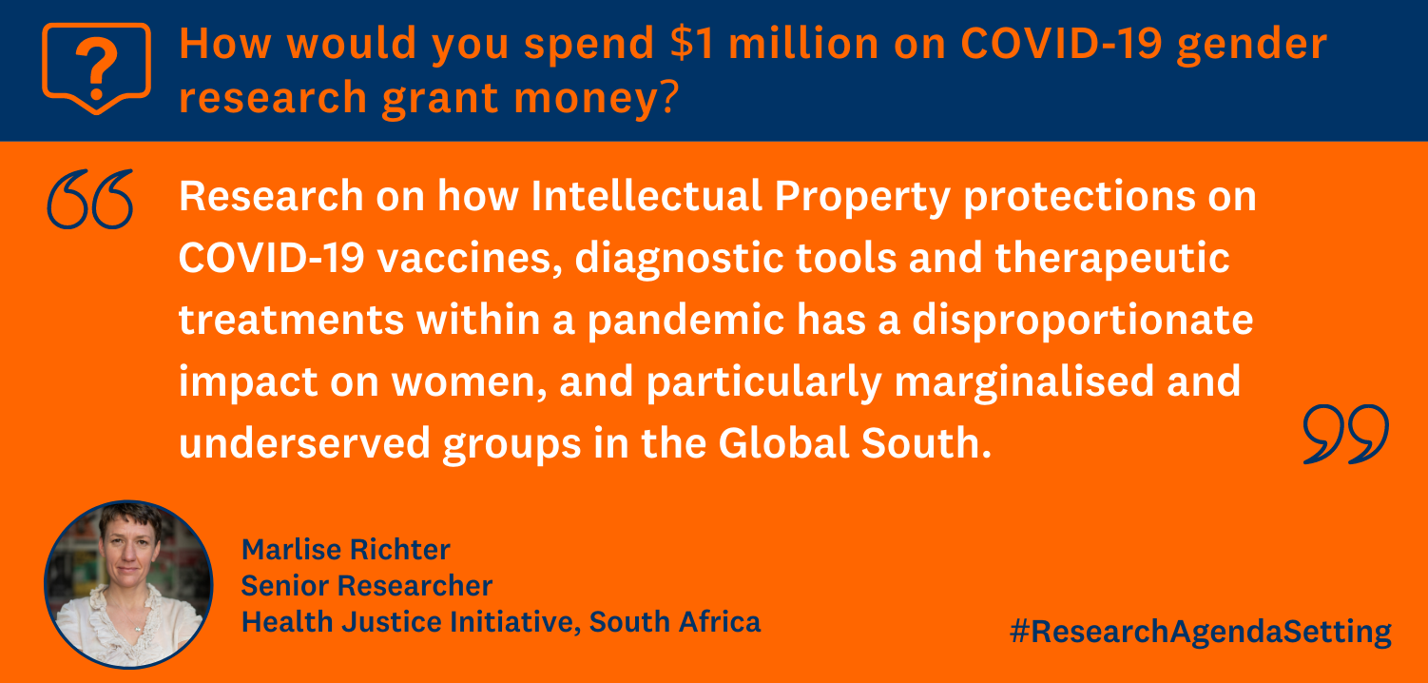
TG2: Research and Development
Notes:
Very brief comment noting that we included contributions addressing all levels of the health system, including at the macro level in terms of how patents are decided on and with what effect on those most marginalized among LMIC populations

Slide 5
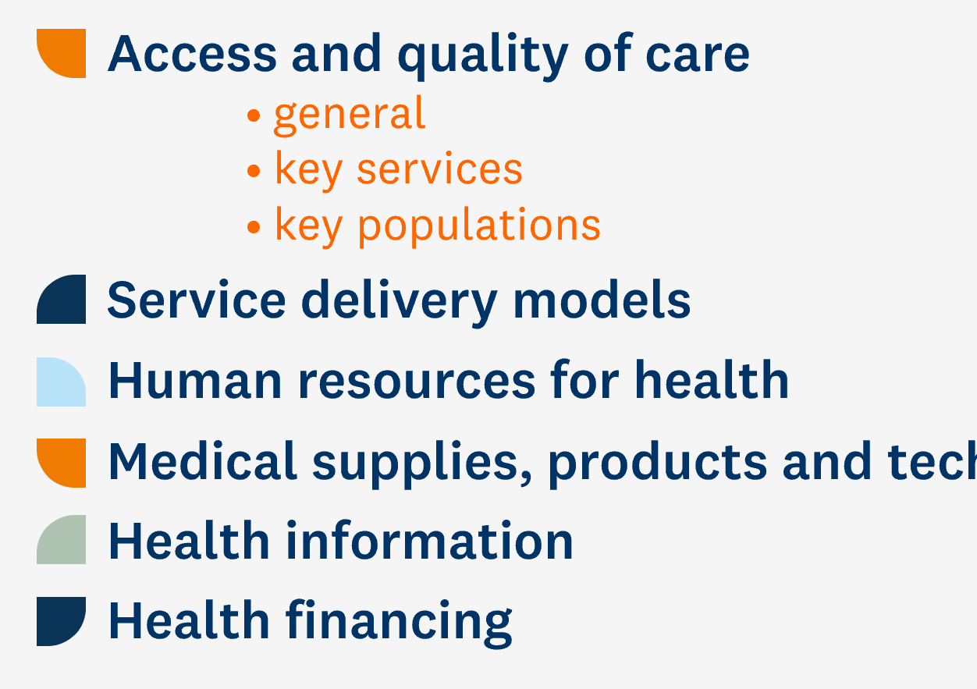


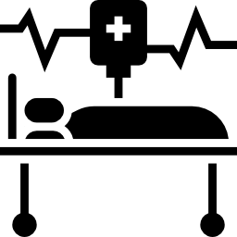



TG3: Health Services
 | Priority Research Questions
 | Access: To what extent, and how has, utilization of quality sexual, reproductive and maternal health and violence against women services changed because of COVID-19?
 | Access: How has the prioritization of COVID-19 services affected access to services for non-COVID-19 health conditions by gender and its intersection with other social categories
 | Access: How does access and quality of services for COVID-19 differ by gender and its intersection with other social categories (such as race, disability, migrant status, age, sexuality, etc) in various contexts?
 | Access: How did health service delivery measures respond to the needs of pregnant women who tested positive for COVID-19?
 | Access: What strategies were used to improve gender and other inequities in access and quality of care for COVID-19 services (testing, facility-based care, quarantine care, etc) and how effective were they?
 | Service delivery models: What are the different service reorganization models implemented to ensure continuity of sexual and reproductive health (SRHR) and violence against women and girls (VAWG) services during the pandemic, and how effective are they
Notes:
Very brief comment that although the survey focussed on all dimensions of health services including health workforce and financing, key takeaways are that:
All priority questions relate to access ( vs )
Two questions on what strategies to address access

Slide 6
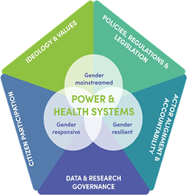


TG5: Governance
 | Priority Research Questions
 | Data & Research Governance: How to best support national statistical systems to produce and use sex and gender data during COVID-19 and future pandemics
 | Gender mainstreaming: What do responsive and resilient health systems that address gender bias and advance gender equality look like?
 | Gender mainstreaming: To what extent, and how, is gender considered in the current decision making and learning processes for COVID-19?
Notes:
Very brief comment on Key takeaways: 1) sex disaggregated data as the backbone to better decision making, 2) envisioning a gender bias free health system, 3) reviewing how gender is considered during decision making

Slide 7
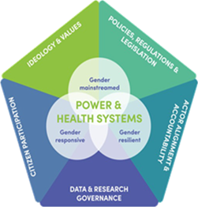
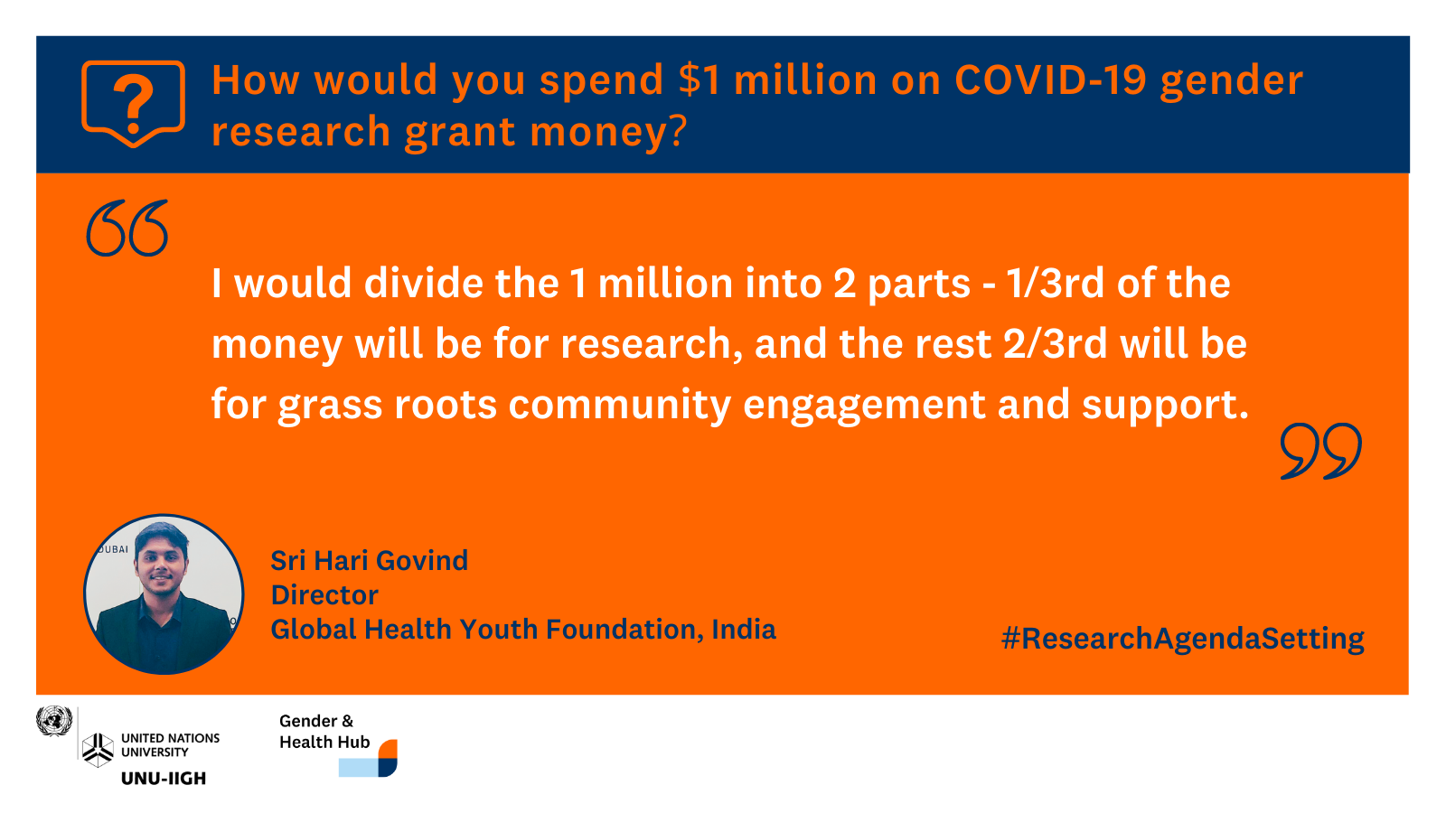
TG5: Governance
Notes:
Very brief…research must have impact, and the engagement of those at the very bottom: community actors

Slide 8
Integrate & Increase $$
Integrate sex & gender into existing research investments & platforms
Increase investment in high-impact and high-quality research that addresses
Sex and gender in vaccine and therapeutics R&D
Real-time research on vaccine hesitancy and uptake
Indirect and long-term impacts on health and wellbeing, including GBV, mental health
Implementation research to design, evaluate and learn from gender-responsive policies, responses and adaptations in health service delivery that promote gender equality or mitigate gender inequalities
Research that supports multi-sectoral action to address to gendered social determinants and consequences of COVID-19 on those most marginalized
Research that reveals and transforms the gender power dynamics in health system decision making for COVID-19
Notes:
Spend more time on this slide as these are not just research priorities, but also ways of reforming the health systems that we have

